Slide 1
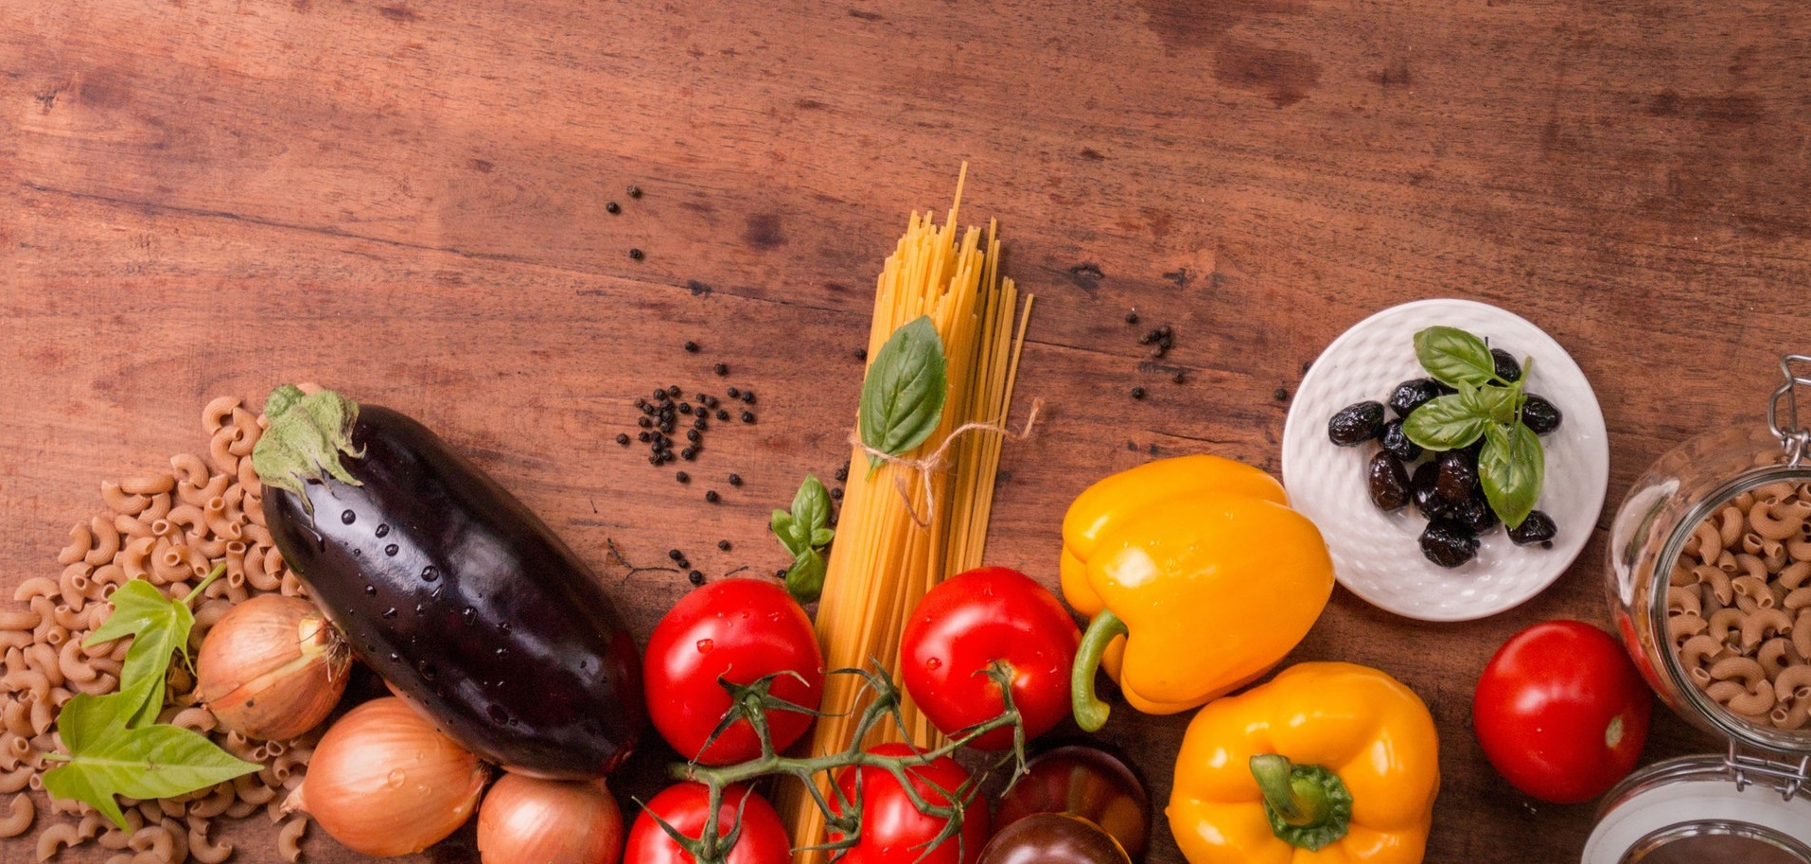
WELCOME

Slide 2
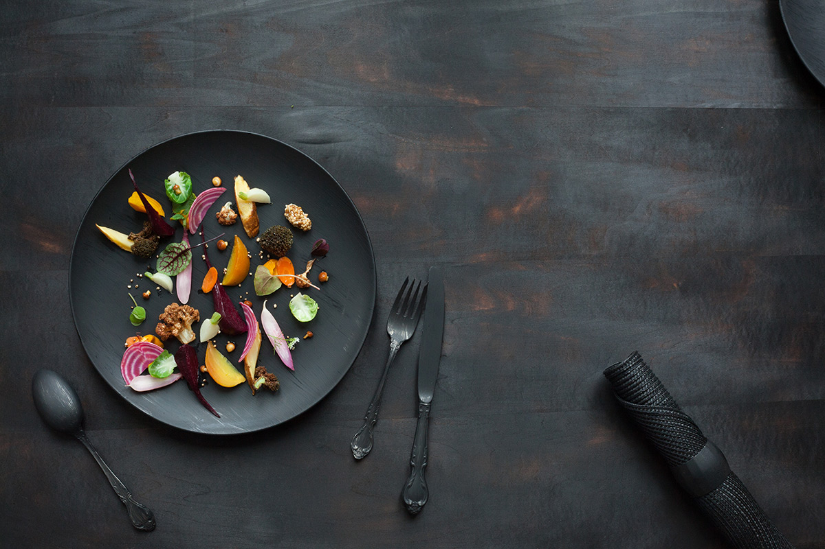
ONLINE FOOD ORDER
Le cafe’

Slide 3
INTRODUCTION
“Online Food Order ” is the process of food delivery or takeout from a local restaurant or food cooperative through a web page. Much like ordering consumer goods online, many of these services allow customers to keep accounts with them in order to make frequent ordering convenient.

Slide 4
OBJECTIVES
To develop a system that will surely satisfy the customer service.
To evaluate its performance and acceptability in terms of security, user friendliness, accuracy and reliability.
To improve the communication between customer and server and minimizing the time of ordering.
To automatically compute the bill.
The system will also automatically calculate and display the final bill.so bill will be error free and more accurate .
Providing single platform for customers’ orders and restaurants.
Online menu with multiple food varieties.
Easy access for the customers to place and receive orders.
Providing the payment gateway for the restaurant.

Slide 5
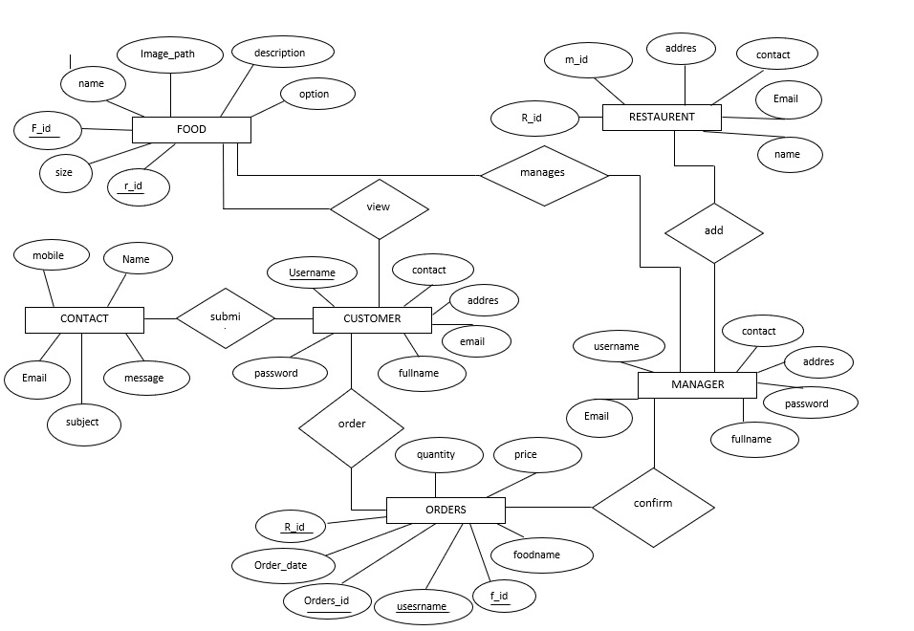
E-R DIAGRAM

Slide 6
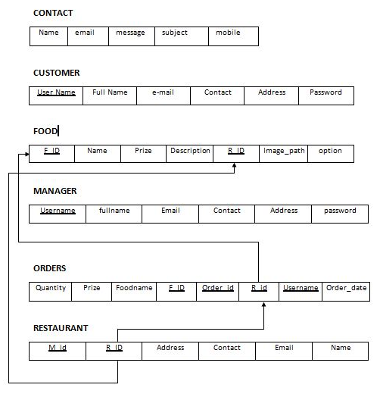
SCHEMA DIAGRAM

Slide 7
SYSTEM REQUIREMENTS SPECIFICATION
HARDWARE REQUIREMENTS
Intel CORE i5 processor
Memory – 8GB (ram)
Hard disk –1TB
SOFTWARE REQUIREMENTS:
Operating System - windows 7 /8 or higher version
Platform - XAMPP
Front end - php,html,css,js
Back end - MY SQL (Database)

Slide 8
SNAPSHOTS

Slide 9
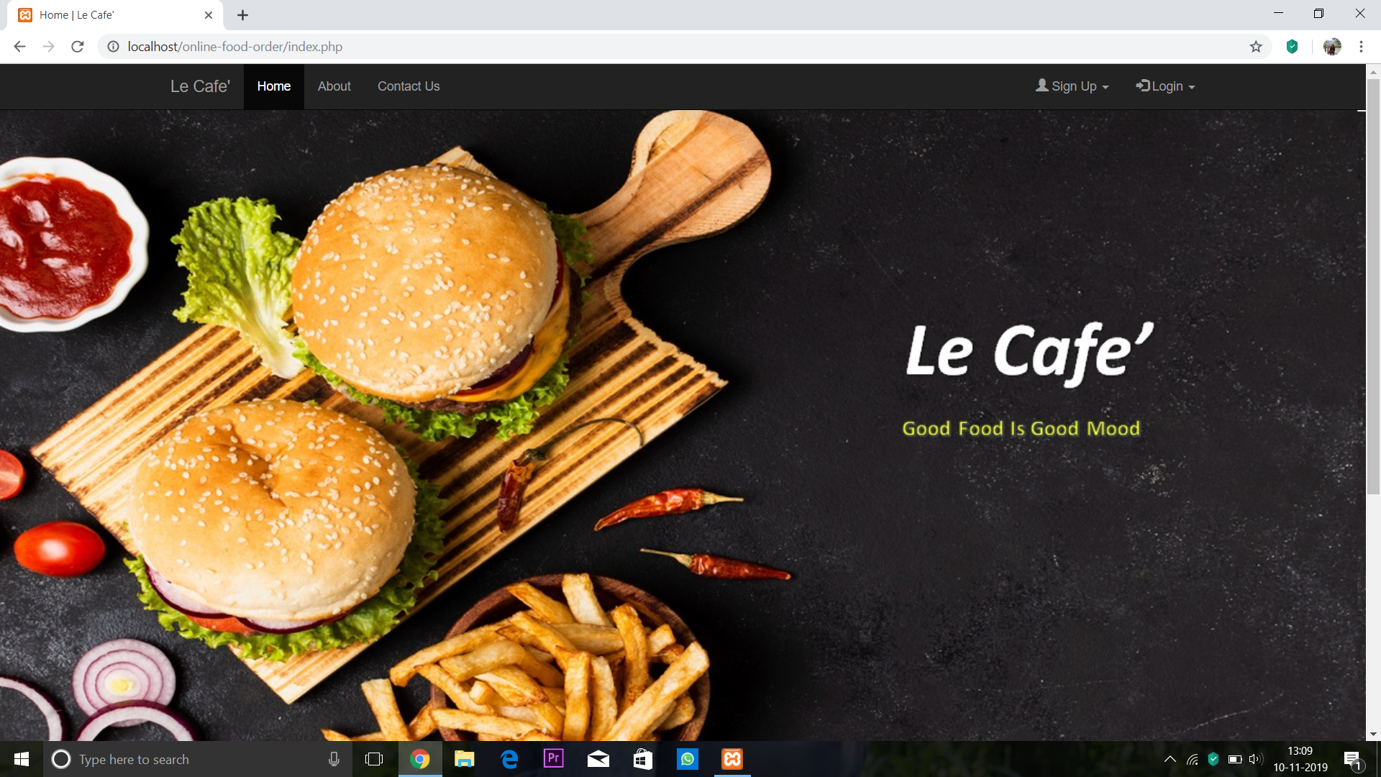
HOME PAGE

Slide 10
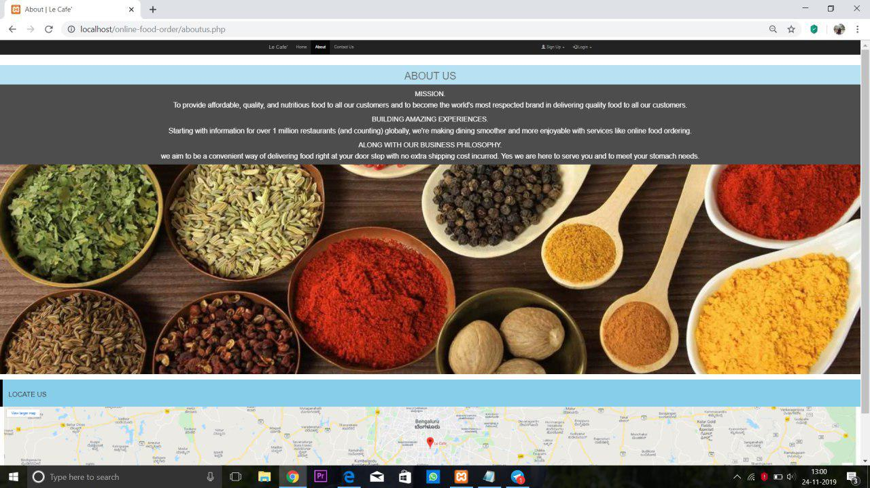
ABOUT PAGE

Slide 11
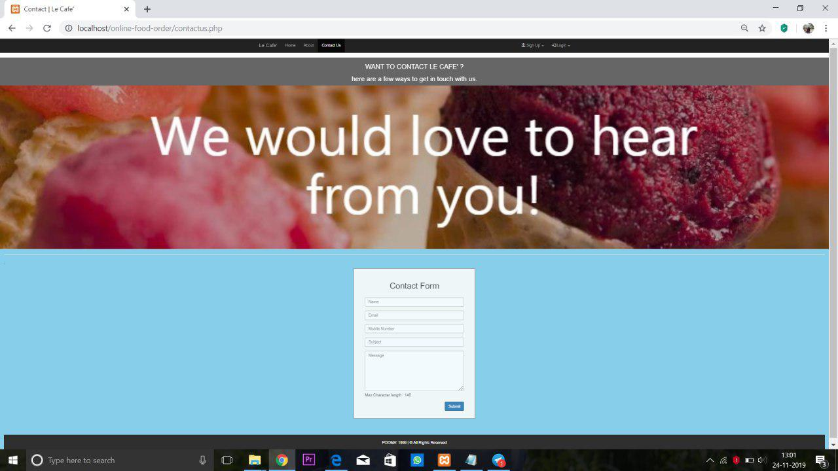
CONTACT PAGE

Slide 12
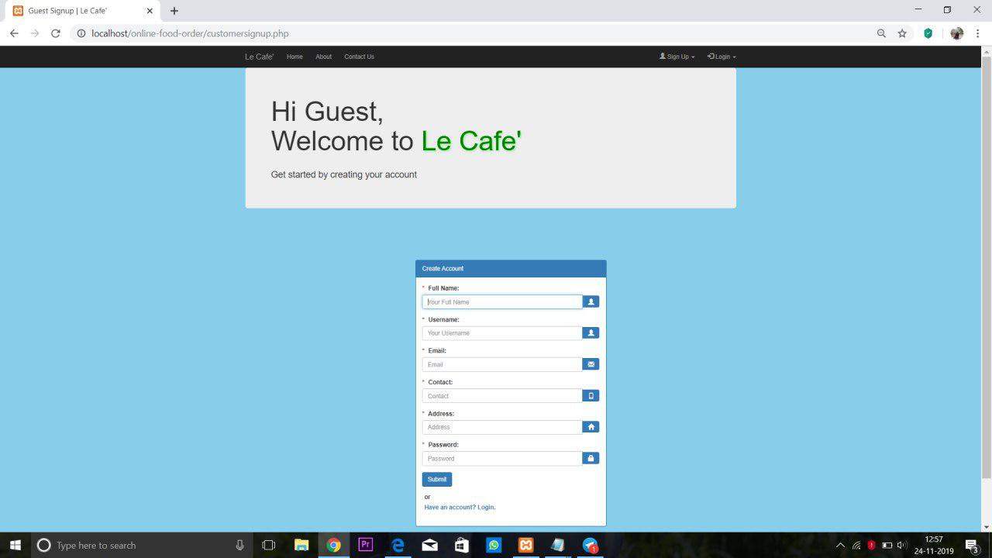
CUSTOMER REGISTRATION PAGE

Slide 13
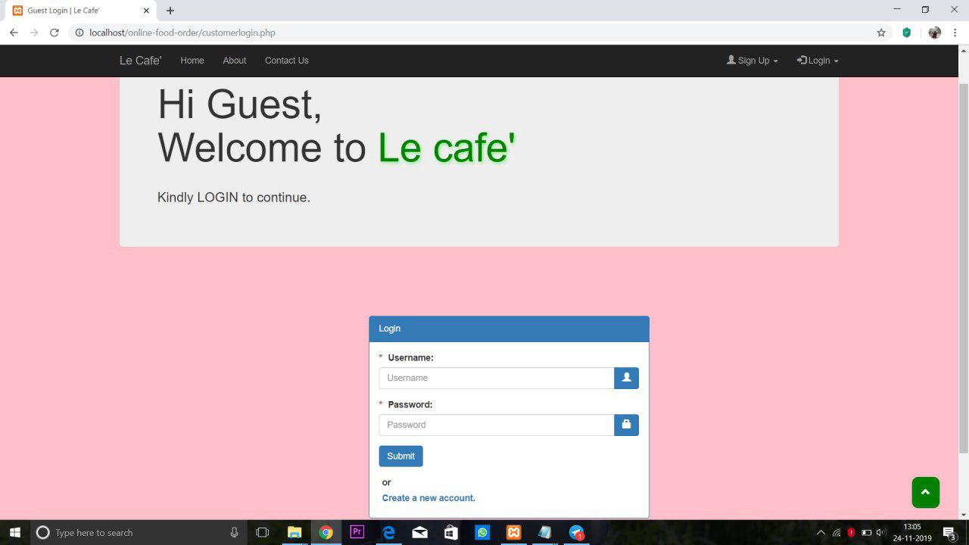
CUSTOMER LOGIN PAGE

Slide 14
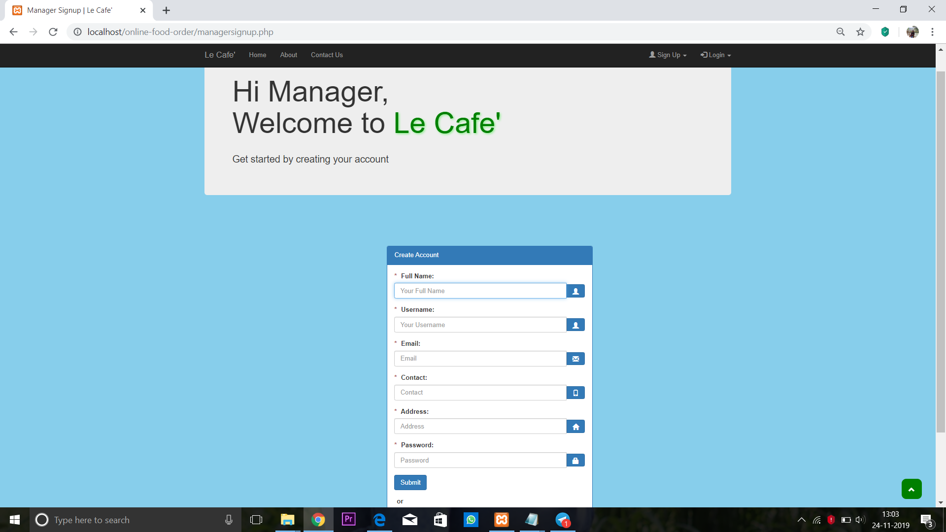
MANAGER RIGISTER PAGE

Slide 15
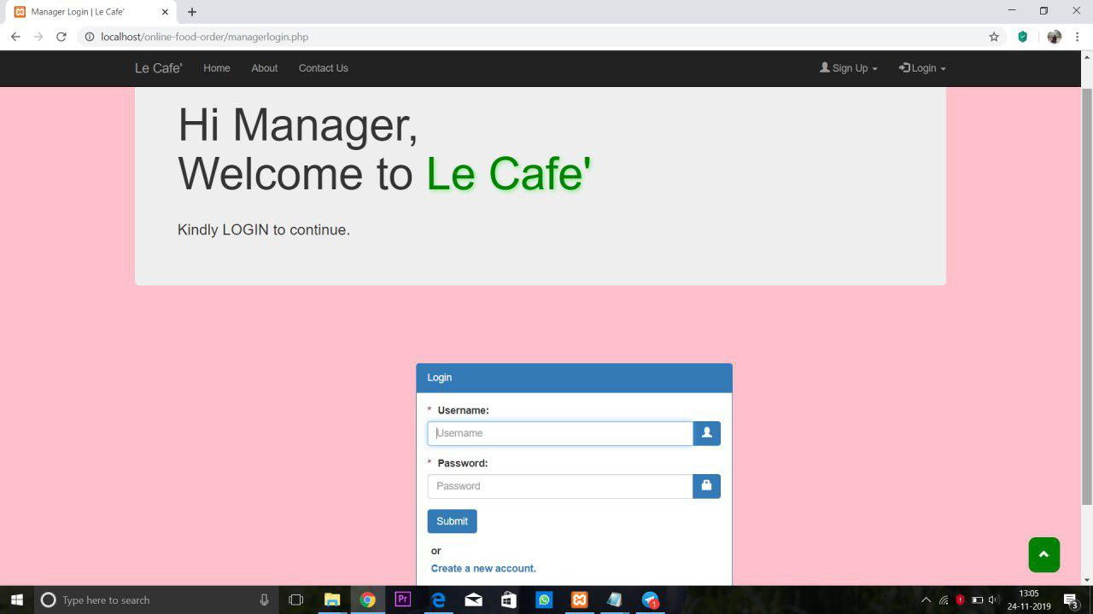
MANAGER LOGIN PAGE

Slide 16
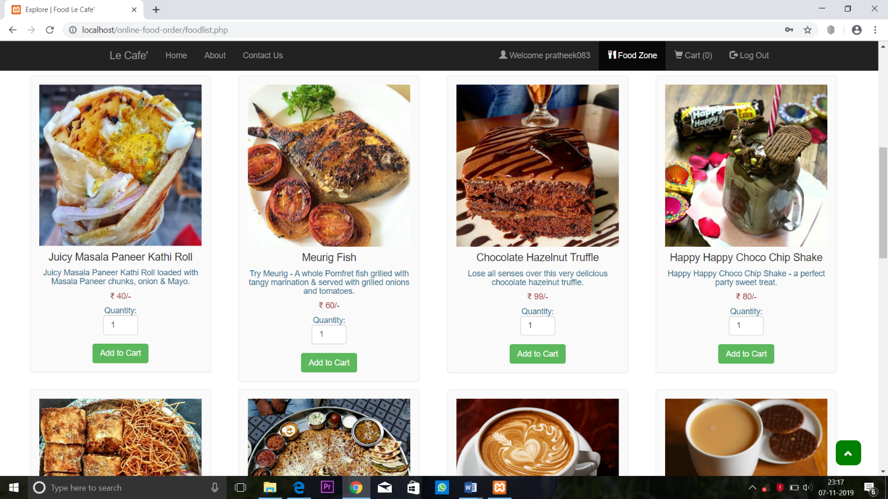
MENU PAGE

Slide 17
OUTCOMES
Online Food Order and Delivery can be used to manage the information of food , order and the user details.
Used to order food online Record the details of the user for further ordering convenience.
It provides the user-friendly interface. All the data will be saved in the database.
So administrator can easily view all the data on time.
Online Food Order and Delivery DBMS mini project reduces the manual work.
It keeps the records food ordered and delivered.
This application can allow the users to pay amount through cash only while delivering items.

Slide 18
CONCLUSION
This mini project “Online Food Order” was being started designing by taking int consideration the Implementation into the Real World.
At the start of the project we had an aim of making this project more specific to the real world and making it applicable to more number of restaurants throughout the city and provide each restaurant their own specific menu, so that anyone who is using this application can order the food from the menu provided by the specific restaurant they prefer.

Slide 19
THANK YOU

